Slide 1
35 Excel Tips
That Could Save You from Working All Night
- Version 2.0 -
Cuong Do, Berthold Trenkel-Bögle
February 1, 2001

Slide 2
INTRODUCTORY NOTE
What is it: The following material was developed for the Seoul office training program.
Target audience: 1st year associates and business analysts, although there is nothing wrong doing this training as well with EMs and APs.
Duration: 3-4 hours to walk through the explanations and give everyone a chance to actually practice.
Faculty: SEO did it with 2 MGMs, which was extremely powerful, since the seniors showed that they can do and therefore they can expect their team members to do the same.
Final comment: The original material was not intended for self-study purposes and therefore may be a little be too brief and cryptic in some cases. In case you have any improvement ideas please feel free to e-mail them to the authors.
Thank you: We‘ve received great feedback and many ideas how to improve this document. But the best contributions came from Tim Morse-NY, who‘s ideas have been incorporated in this version. Thanks.

Slide 3
35 EXCEL TIPS THAT COULD SAVE YOU FROM WORKING ALL NIGHT
1. Split windows and freeze panes
2. Hide and Unhide command
3. Moving around a spreadsheet with Ctrl, Shift, and Arrow keys
4. Name cells/ranges
5. Sort command
6. Toggling among relational and absolute references
7. Fill down and fill right commands
8. IF function
9. AND and OR functions
10. SUM and SUMIF functions
11. Subtotals and Totals
12. SUMPRODUCT function
13. NPV function
14. COUNT functions
15. ROUND, ROUNDUP and ROUNDDOWN functions
16. VLOOKUP and HLOOKUP functions
17. Insert Function command
18. Paste Special command
19. Auditing features
20. Goal Seek add-in
21. Solver add-in
22. Data tables
23. Scenarios add-in
24. Pivot Tables
25. Protecting cells and worksheets
26. Editing multiple worksheets simultaneously
27. Conditional formatting
28. Autofilter command
29. Customize tool bars
30. Changing default workbook
31. Group and Ungroup your spreadsheet
32. Switch off the Microsoft Actors
33. Clean up text
34. Keyboard shortcuts
35. Final thoughts

Slide 4
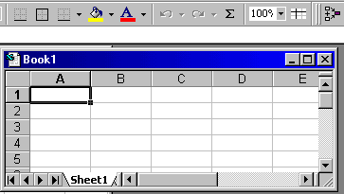
1. SPLIT WINDOWS AND FREEZE PANES
Why you need to know this
  Splitting a window allows you to work on multiple parts of a large spreadsheet simultaneously
  Freezing the pane allows you to always keep one part of the spreadsheet (e.g., column or row labels) visible
How you use this feature
  Drag the split horizontal and split vertical icons to the desires positions
  Click on the freeze pane icon from the tool bar to freeze the panes
Freeze pane icon
Split screen icons
  Split the screen so that:
    The row with column labels shows up in the top pane
    The column with store names show up in the left pane
  Freeze the panes
Exercise

Slide 5
2. HIDE AND UNHIDE COMMAND
Why you need to know this
  Allows you hide and unhide particular rows or columns
    Simplifies working with the spreadsheet
    Prevent certain information from being seen
How you use this feature
  Select the row(s) or column(s) to be hidden/unhidden
  Select Format : Row : Hide/Unhide or Format : Column : Hide/Unhide
Exercise
  Hide the Avg Sale/Ticket column

Slide 6
3. MOVING AROUND A SPREADSHEET WITH CTRL, SHIFT, AND ARROW KEYS
Why you need to know this
  Save you lots of time
  Move the first or last cell of a contiguous data block without scrolling
How you use this feature
  Ctrl-Arrow : Move to the first/last data cell in the arrow direction
  Ctrl-Shift-Arrow : Selects the cells between the current cell and the first/last data cell
Exercise
  Select all cells with data using the Ctrl, Shift, and Arrow keys

Slide 7
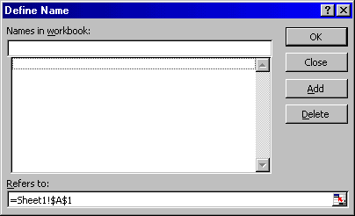
4. NAME CELLS/RANGES
Why you need to know this
  Allows specific cells or cell ranges to be referred to by name
  Allows you to write equations such as = Quantity*Cost instead of =$B$12*$C$4
How you use this feature
  Select the cell or cell range
  Select Insert : Name : Define from the menu bar
Exercise
  Define cells A2:A125 as “Sequence”

Slide 8
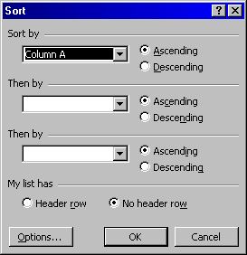
5. SORT COMMAND
Why you need to know this
  Correctly sorting a series of rows or columns without disassociating the data is critical to many modeling efforts
  To sort by single category, just click into column, NEVER highlight column (would destroy table integrity)
  To use multiple criteria, click any cell of data table, select Data…Sort
  Data table will be selected
How you use this feature
Can sort by up to 3 categories, use drop lists to select fields, specify A-Z or Z-A

Slide 9
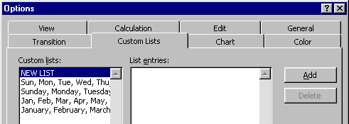
5. SORT COMMAND (CONTINUED)
How you use this feature
  Indicate if have Header row, which will not be included in sort
  Select Options to use Custom lists (create first, see below)
  Select Tools/Options/Custom Lists to create specialized sort orders, e.g.
    To sort months and weekdays according to their calendar order instead of their alphabetic order
    To rearrange lists in a specific order (such as High/Medium/Low entries)
Exercise
  Create your own sorting list with labels as you like

Slide 10
6. TOGGLING AMONG RELATIONAL AND ABSOLUTE REFERENCES
Why you need to know this
  Saves you lots of time
How you use this feature
  F4 key toggles through the different options

Slide 11
7. FILL DOWN AND FILL RIGHT COMMANDS
Why you need to know this
  Saves you lots of time
  Allows for copying of cell content to contiguous cells with a single keystroke
How you use this feature
  Select the cell with the content to be copied and drag to select the cells to which the content should be copied
  Ctrl-R to fill right
  Ctrl-D to fill down
Caution!!
  Double-check your formulas for absolute vs. relative references!!
Exercise
  Calculate the total daily sales for each store

Slide 12
8. IF FUNCTION
Why you need to know this
  Conditional comparisons are used in virtually all spreadsheets
  Knowing how to use IF in a nested manner and in combination with other functions will save hours of time
How you use this feature
  IF(Comparison,TrueAction,FalseAction)
  IF(Comparison,TrueAction,) ==> Cell shows 0 if condition is false
  IF(Comparison,TrueAction,””) ==> Cell shows blank if condition is false
  Create a “Seoul” variable
    1 if the store is in Seoul
    0 if the store is in other places
Exercise

Slide 13
9. AND AND OR FUNCTIONS
Why you need to know this
  Used with the IF function to enable more complicated logical comparisons
How you use this feature
  AND(Comparison 1,Comparison2,Comparison3,…)
  OR(Comparison 1,Comparison2,Comparison3,…)
  Create a variable that calculates daily sales per pyung only for:
    KFC stores in Seoul with size larger than 50 pyung
    All BK stores
Exercise

Slide 14
10. SUM AND SUMIF FUNCTIONS
Why you need to know this
  SUM is used in virtually all spreadsheets
  SUMIF can save lots of time in most spreadsheets if you know how to use the function
How you use this feature
  SUM(Range1,Range2,Value1,…)
  SUMIF(Range,”Comparison”,SumRange)
    If a SumRange IS NOT specified, SUMIF sums the cells meeting the Comparison criteria in the specified Range
    If a SumRange IS specified, SUMIF sums the cells in SumRange where the corresponding cells in Range meets the Comparison criteria
  NOTE: The “” signs must be used for the Comparison value
  Calculate the total store space for stores larger than 50 pyungs
  Calculate the total daily sales for all stores larger than 50 pyungs
Exercise

Slide 15
11. SUBTOTALS AND TOTALS
Why you need to know this
  Want to add lines with subtotals in your P&L or balance sheet, but still need to run the total over all numbers? Don’t want to get confused with nested subtotals and totals in your spreadsheet?
How you use this feature
  Instead of ‘=sum(range)’ add ‘=subtotal(9,range)’ where you need a subtotal or total.
  You may nest this function as you like. Excel keeps track of everything
  Create a simple column with various numbers
  Add various subtotals running over various parts of your spreadsheet and finally over the whole column
Exercise

Slide 16
12. SUMPRODUCT FUNCTION
Why you need to know this
  If you need to multiply two column and need the sum of the multiplication, sumproduct comes easy.
How you use this feature
  Insert =sumproduct(range1,range2)
Exercise
  Multiply two columns or rows and get the sum of it

Slide 17
13. NPV FUNCTION
Why you need to know this
  Of course you can create your own discounting table and then calculate the NPV of your cash flow series or just use the NPV function
How you use this feature
  Insert =NPV(discount rate,cash flow numbers,...)
  The discount rate is in percent
  The cash flow numbers are either an array or individual numbers in individual cells
  Attention: The first cash flow number is in period 1, e.g. the end of the period. If you have for example an initial investment in period 0, just type =NPV(…)+period 0 payment in your calculation
Exercise
  Create a list of random cash flows and calculate the NPV with the NPV function

Slide 18
14. COUNT FUNCTIONS
Why you need to know this
  Prevents you from wasting time counting items manually or creating dummy variables to count such items
How you use this feature
  COUNT(Range1,Range2,Value1,...) ==> count the number of cells containing numbers
  COUNTA(Range1,Range2,Value1,...) ==> count the number of non-empty cells
  COUNTBLANK(Range) ==> count the number of empty cells in the range
  COUNTIF(Range,”Criteria”) ==> count the number of cells in the Range containing the Criteria. NOTE: The “” signs must be used for the Criteria value
Exercise
  Calculate the number of KFC stores in the dataset

Slide 19
15. ROUND, ROUNDUP AND ROUNDDOWN FUNCTIONS
Why you need to know this
  Many situations exist when you need to have exact numbers instead of various fractions in your calculations (e.g., there cannot be 536.235 bank branches)
How you use this feature
  ROUND(Number,Digits) ==> Round the number (or cell) to the specified number of digits
    If Digit = 0, then Number is rounded to nearest integer
    If Digit > 0, then Number is rounded to the specified number of decimal places
    If Digit < 0, then Number is rounded to the specified number of digits left of the decimal place
  ROUNDDOWN(Number,Digits) and ROUNDUP(Number,Digits) work the same way as ROUND, but the direction of rounding is specified by the function
Exercise
  Calculate a rounded Avg Sale/Ticket variable, rounding to the nearest 10 Won

Slide 20
16. VLOOKUP AND HLOOKUP FUNCTIONS
Why you need to know this
  Allows you to automatically lookup a particular cell of data from a larger data range. This is especially useful when you have
    A large data section that contains information for multiple records somewhere on the spreadsheet (e.g., a small database)
    A calculation area somewhere else, and you need to refer to some specific data elements for specific records

Slide 21
16. VLOOKUP AND HLOOKUP FUNCTIONS (CONTINUED)
How you use this feature
  VLOOKUP and HLOOKUP allows you to find a specific cell of data in a larger data range
    Use VLOOKUP when each row contains a separate record and the associated columns contain data for that one record
    Use HLOOKUP when each column contains a separate record
  VLOOKUP(SearchValue,Range,ColumnNumber,Error) ==> look for a value in the row specified by SearchValue and the column specified by ColumnNumber
    SearchValue indicates the “match key” (i.e., find the row that contains the SearchValue in the first column)
    Range specifies the cells containing the data
    ColumnNumber specifies the column that contains the data element you want
    Error determines what happens when Excel does not find the exact SearchValue you want. FALSE leads Excel to display a #N/A when an exact match cannot be found. TRUE leads Excel to display the next smaller value than SearchValue
  HLOOKUP(SearchValue,Range,RowNumber,Error) ==> look for a value in the column specified by SearchValue and the row specified by RowNumber
NOTE: The 1st column of data must be sorted in ascending order when using VLOOKUP, and the 1st row of data must be sorted if using HLOOKUP

Slide 22
16. VLOOKUP AND HLOOKUP FUNCTIONS (CONTINUED)
  Define a name for the cells containing the data and use that name as the Range. Do not include the row/column label in the named range because this would break the ascending sort rule above.
  Insert an extra row above your column label to number the columns
Tip
  Use VLOOKUP to find out how many seats are in the Duksung store? How many passers-by for the store?
Exercise

Slide 23
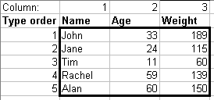
16. VLOOKUP AND HLOOKUP FUNCTIONS (CONTINUED)
Number the columns to easily check your formulas
Define a name for cells in your data Range
Need to sort in ascending order for VLOOKUP function to work properly

Slide 24
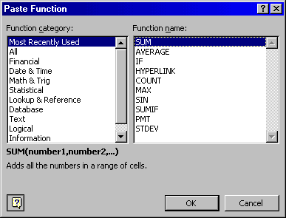
17. INSERT FUNCTION COMMAND
Why you need to know this
  What do you do if you do not know what functions are available or how to enter the arguments for a function?
How you use this feature
  Select the cell
  Select Insert : Function from the menu bar
Exercise
  Calculate the median daily ticket count for all the stores

Slide 25
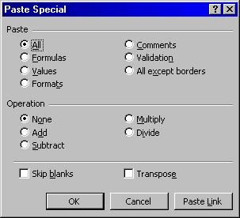
18. PASTE SPECIAL COMMAND
Why you need to know this
  Saves you lots of time
    Retyping formulas
    Converts formulas into values
    Reformatting cells
    Transposing cells (i.e., convert row-entered data blocks into column-entered ones)
How you use this feature
  Copy the cells of interest
  Place the cursor where you want to past the information
  Select Edit : Paste Special from the menu bar
  Select the appropriate options from the dialog box that appears
  Convert the Rounded Avg Sale/Ticket calculations into values (i.e., get rid of the formulas)
  Copy and paste the entire dataset into a new spreadsheet in transposed manner
Exercise

Slide 26

19. AUDITING FEATURES
Why you need to know this
  Quickly find the cells referenced by a formula and/or quickly find which cells reference a particular cell of interest
How you use this feature
  Select View : Toolbars : Customize from the menu bar. Check the Auditing box from the Toolbars tab
  Click on the cell of interest
  Select the Trace Precedents or Trace Dependents icon from the Auditing Toolbar
Exercise
  Find the cells that references the Daily Ticket Count for the Ansan store

Slide 27
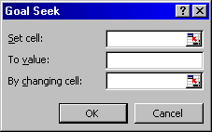
20. GOAL SEEK ADD-IN
Why you need to know this
  Easily find what one input variable needs to be to achieve some desired result in a calculation
How you use this feature
  Select the calculated cell
  Select Tools : Goal Seek from the menu bar
  Enter the desired resulting calculation into the “To Value” form in the dialog that appears
  Enter the input cell in the “By changing cell:” form
Exercise
  How many additional daily tickets would the Achasan store need to have a total daily sales of 2,000,000 Won?

Slide 28
21. SOLVER ADD-IN
Why you need to know this
  Allows you to use linear programming to find the optimal inputs to achieve some desired calculational result (e.g., maximize revenues by increasing daily tickets, increasing store size, average sale/ticket, etc. simultaneously)
  Use Solver instead of Goal Seek when:
    You need to place constraints on the input variable (e.g., cannot open a store for more than 24 hours a day)
    More than 1 input variables are involved
    You want to minimize or maximize the resulting calculation in addition to just setting the calculation to a predetermined value

Slide 29
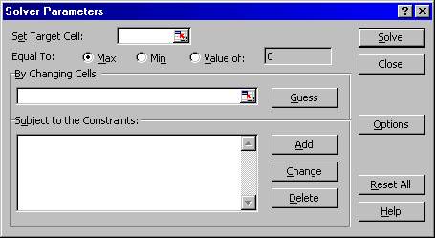
21. SOLVER ADD-IN (CONTINUED)
How you use this feature
  Select the final calculated cell, then select Tools : Solver from the menu bar
  Select what you want to do from the “Equal to” section (i.e., maximize, minimize, or set to a specific value)
  Reference the input cells (note, separate cells by using a comma or “:” if cells are contiguous
  If the input values have constraints, click on Add to enter the constraints
  Click on Solve
  What is the maximum daily sales per pyung for the Ansan store if:
    The store can be opened a maximum of 18 hours/ day, 7 days/week
    Store size can expanded up to a maximum of 87 pyung
Exercise

Slide 30
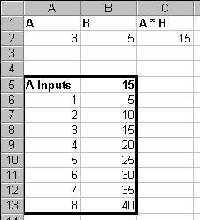

22. DATA TABLES COMMAND
Why you need to know this
  Simplest way to run sensitivity analyses
  Input the values you want to test for a particular variable on separate rows (e.g., A6:A13)
  In the cell above and to the right of the first sensitivity value, reference the final result of your calculations (e.g., A5 = C3)
  Select the cells containing the calculation and input variables (e.g., A5:B13)
  Select Data : Tables from the menu bar
  Input the cell referenced by the formula in the“Column input cell”(e.g., A2). This example uses in “Column input cell” because the value to test in the sensitivity analysis are arranged in a single column
How you use this feature

Slide 31
22. DATA TABLES COMMAND (CONTINUED)
  What daily total sales would the Achasan store have its daily ticket counts ranged from 400 to 600 each day (in increments of 50)?
Exercise

Slide 32
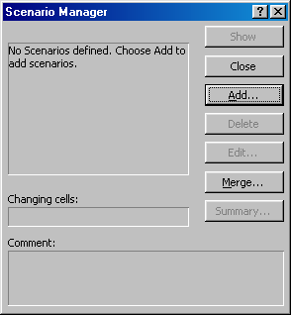
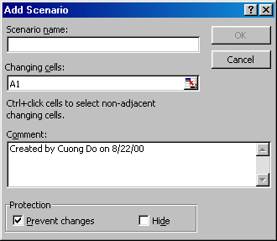
23. SCENARIOS ADD-IN
Why you need to know this
  You’ve created a model and need to run various scenarios. Then use the scenario function under the tools menu. Keeps your inputs and outputs from the model nicely together
  Assign names to the excel cells that act as input parameters for your model
  Start the scenario function by selecting Tools : Scenarios from the menu bar.
  Click Add to enter your first scenario
    Create a name
    Select ALL cells that will be your input to the model.
  Assign the desired scenario value to each input parameter.
  Add more scenarios as needed
  When finished click on summary and select scenario summary (the pivot table is not so helpful)
How you use this feature

Slide 33
23. SCENARIOS ADD-IN (SIMPLE EXAMPLE)
Objective:
You want to build a simple model to understand under which scenarios Airbus should build the A3XX a next generation super large airplane with more than 600 seats
Simple model:
Profit = number of planes sold x price x margin - development cost
Scenarios Worst case Realistic Best case
No. of planes 200 350 500
Price (million. USD) 120 130 150
Margin 20% 25% 30%
R&D 13 billion USD 12 billion USD 11 billion USD

Slide 34
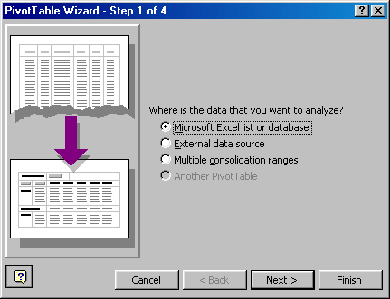
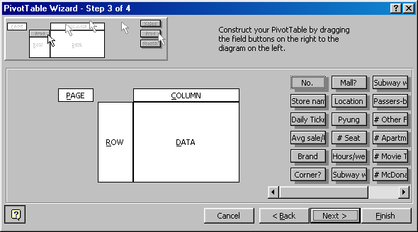

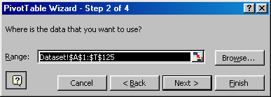
24. PIVOT TABLES
Why you need to know this
  Most powerful tool to arrange huge amounts of data in a more structured way than pure sorting. In particular helpful to run quick sums, averages, distributions, etc. in combination with a structure criteria, e.g. total number and average sales per store size band
How you use this feature
  Select Data: PivotTable Report…
Step 1: Microsoft Excel list
Step 2: Select the relevant data area
  Step 3: Drag and drop data elements on row and column (this is your table structure), the data you want to analyze on the data area
  Step 4: Just press Finish

Slide 35
24. PIVOT TABLES (CONTINUED)
  Draw a distribution chart for the number of stores per size in pyung bucketed each 10 pyung wide
  Arrange the store distribution by store size (each 10 pyung) and daily tickets (each 100 tickets) and show the number of stores per each category
Exercise

Slide 36
25. PROTECTING CELLS AND WORKSHEETS
Why you need to know this
  Sometimes you want to give your Excel file to someone else and prevent them from changing the formulas for seeing some hidden cells
  Protecting a spreadsheet or workbook involves two steps
    Designating which cells to be locked or hidden
    Protecting the spreadsheet or workbook
  Note several weird peculiarities:
    The default for all cells in a spreadsheet if LOCKED. So if you want the receiver of your worksheet to change the content of a cell, unlock the cell before protecting the spreadsheet
    The formulas in a cell can be seen even if the spreadsheet is lock -- UNLESS you hide that cell before protecting the spreadsheet
  To lock/unlock and hide/unhide a cell, select the cell(s) and select Format : Cell. Select the Protection tab when the dialog box appears
  To protect/unprotect a spreadsheet, select Tools : Protection : Protect Sheet
How you use this feature
Exercise
  Protect the dataset spreadsheet
    Allow the user to change the data
    Lock and hide the formulas you entered

Slide 37

26. EDITING MULTIPLE WORKSHEETS SIMULTANEOUSLY
Why you need to know this
  Avoid having to redo your work on multiple spreadsheets in a single workbook
How you use this feature
  Select the first spreadsheet to be edited
  Hold the Ctrl key while clicking on the additional spreadsheets
  Do your editing
Exercise
  Try it

Slide 38
27. CONDITIONAL FORMATTING
Why you need to know this
  Sometimes you would to color the output of cells in different colors, e.g. negative numbers in red, positive numbers in black, or add a frame, etc.
How you use this feature
  Mark the relevant fields and select Format: Conditional Formatting
  Select the criteria for the format and adjust the format. You can actually change the font, the border and the color
  Click on Add to select additional criteria for the formatting
  Format a cell to be in red font, with blue background for negative numbers and in bold font with thick border, if the value is above 10
Exercise

Slide 39
28. AUTOFILTER COMMAND
Why you need to know this
  You have a huge pile of data and quickly want to find some specific information, e.g. all sets that meet a criteria or the top 10 items etc.
How you use this feature
  Click into your table or better mark the data area and select Data: Filter: Autofilter
  Using the drop-down boxes per item allows you to display only specific filtered information
  Selecting multiple matches (up to 3 maximum with autofilter) you can narrow down your search
  Or add your own criteria for filtering by clicking on the custom criteria
  Find the stores who belong to the top 10% in terms of average sales per ticket AND the top 10 in terms of store size in pyung
Exercise

Slide 40
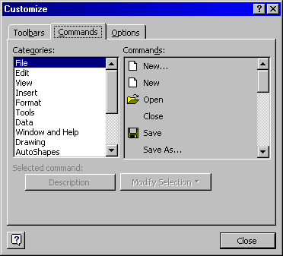
29. CUSTOMIZE TOOL BARS
Why you need to know this
  How many icons on the tool bar to you use regularly?
  How often do you have to use the menu bar or mouse to do something you wish were accessible with a single click?
How you use this feature
  Select View : Toolbars : Customize
  Click on the Commands tab
  Drag items on and off the toolbar as you wish
OR
  Right click toolbar area
    Select Customize
    Select Commands tab in Customize dialog box
    From appropriate menu, find the command for which you want to add button
    Drag button to location on toolbar

Slide 41
29. CUSTOMIZING YOUR TOOLBAR (CONTINUED)
How you use this feature
  Other favorites ...
  Paste values
  Select visible cells
  Save as
  Show comment (toggles it)
  Set print area
  Page setup
  Merge cells
  Auto filter
…or create your own icons!
Auto filter off – show all
Exercise
  Modify your toolbar as desired

Slide 42
30. CHANGING DEFAULT WORKBOOK
Why you need to know this
  How often do you use the menu bar to change the normal font or number formats?
  You can create the basic number and font formats you use regularly, save it as a template, and have Excel use that template every time you create a new workbook
How you use this feature
  Create a workbook with the formatting you use regularly and save it under the name “Book” and Template format
  Move the “Book” template to the Microsoft Office : Office : Xlstart folder
Exercise
  Create your default workbook

Slide 43
31. GROUP/UNGROUP PARTS OF SPREADSHEETS
Why you need to know this
  How often would you like to hide or unhide parts of a complex spreadsheet?
  If your answer is “very often”. You will like to group/ungroup function instead of the hide/unhide command, since you will be able to toggle between hidden or displayed columns or rows.
  Mark the row or column that you would like to “fold”, i.e. hide for the moment.
  Click on Data: Group and Outline: Group
  To “fold” click now on the “minus” sign outside of your column or row
  You may also group or ungroup hierarchically
How you use this feature
Tip
  Group some parts in your spreadsheet
  Also try to remove the grouping
  Use the two “arrow” buttons, which you find on the pivot table toolbar (right click on any toolbar and select PivotTable)
Exercise

Slide 44
32. SWITCH OFF THE MICROSOFT ACTORS
Why you need to know this
  Also find the Microsoft Actors more disturbing than helpful?
  Always popping up at the wrong moment
How you use this feature
  Excel 97
    Start the Windows Explorer
    Go to the directory Program Files: Microsoft Office: Office: Actors
    Rename the directory “Actors” to “Dead Actors”
  Excel 2000
    Go to Tools : Options : Edit and switch off „Provide feedback with animation“
Exercise
  Try to eliminate the Actors

Slide 45
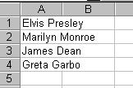
33. CLEAN UP TEXT
Why you need to know this
  Often clients have data on their mainframe. The best you can get for your PC is a text file dump. This trick will help you see through the data „mess“ you‘ve received.
How you use this feature
  One easy method to split text into separate columns is the Data/Text to Column Wizard
    Select the cells
    Select Data/Text to Column

Slide 46
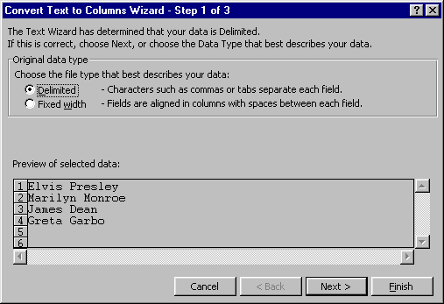
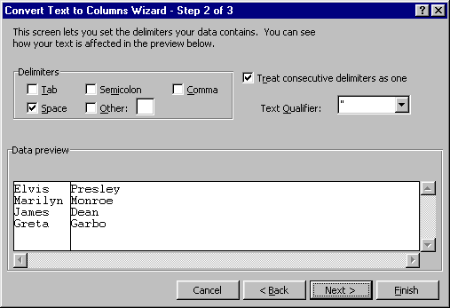
33. CLEAN UP TEXT (CONTINUED)
How you use this feature
  Check that Excel choose correct setting, change as needed

Slide 47
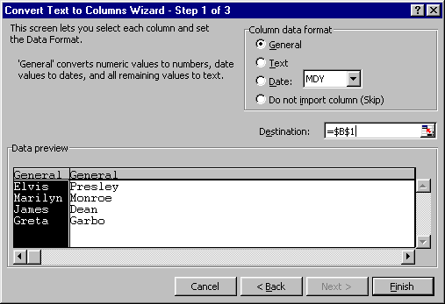

33. CLEAN UP TEXT (CONTINUED)
How you use this feature
  Be sure to supply the destination
  Click finish
Note
  Be sure the are enough empty columns for your conversion at the destination or Excel will OVERWRITE the contents of the cells
  Split data appears in 2 columns

Slide 48
34. KEYBOARD SHORTCUTS
Formatting keys
Alt + ‘
Ctrl + Shift + ~
Ctrl + Shift + $
Ctrl + Shift + %
Ctrl + Shift + !
Ctrl + Shift + &
Ctrl + Shift + _
Ctrl + b
Ctrl + i
Ctrl + u
Ctrl + 9
Ctrl + Shift + 9
Ctrl + 0
Ctrl + Shift + 0
Ctrl + 1
Ctrl + 5
Shift + Space
Ctrl + Space
  Display the style dialog box
  General Num. Format
  Currency format
  Percentage format
  Comma format
  Outline border
  Remove borders
  Bold
  Italic
  Underline
  Hide rows
  Unhide rows
  Hide columns
  Unhide columns
  Format Dialog Box
  Strike Through
  Select the entire row
  Select the entire column

Slide 49
34. KEYBOARD SHORTCUTS (CONTINUED)
Formatting keys
Ctrl + a
Ctrl + x/c/v
Ctrl + d/r
CTRL+SHIFT+*
SHIFT+ arrow key
CTRL+SHIFT+ arrow key
SHIFT+HOME
CTRL+SHIFT+HOME
CTRL+SHIFT+END
  Select the entire worksheet
  Cut/copy/paste
  File cells down/right
  Select the current region around the active cell (the current region is an area enclosed by blank rows and blank columns)
  Extend the selection by one cell
  Extend the selection to the last nonblank cell in the same column or row as the active cell
  Extend the selection to the beginning of the row
  Extend the selection to the beginning of the worksheet
  Extend the selection to the last cell used on the worksheet (lower-right corner)

Slide 50
34. KEYBOARD SHORTCUTS (CONTINUED)
Windows and Workbook keys
Ctrl + F4
Alt + F4
Ctrl + F10
Ctrl + F9
Ctrl + F5
F6
Shift + F6
Ctrl + F6
Ctrl + Tab
Shift + F11
F11
Ctrl + s
F12
Ctrl + o
Ctrl + n
Alt + F8
Alt + F11
  Closes workbook window
  Closes Excel
  Maximizes the workbook
  Minimizes the workbook
  Restore window size
  Next pane
  Previous pane
  Next window
  Next window
  Inserts a new sheet
  Create a Quick Chart Sheet
  Saves the workbook
  Saves As
  Opens a workbook
  Creates a new workbook
  Macros Dialog Box
  Visual Basic Editor

Slide 51
34. KEYBOARD SHORTCUTS (CONTINUED)
Windows and Workbook keys
ALT + TAB
CTRL + TAB
CTRL + Page Up/Page Down
CTRL + Home/End
CTRL + arrow key
  Switch between applications
  Switch between open Excel files
  Go to previous/next worksheet
  Go to the first/last cell of the worksheet
  Go to the next empty cell
Auditing and Calculation keys
Ctrl + ‘ ( ~ )
Ctrl + [
Ctrl + Shift + {
Ctrl + ]
Ctrl + Shift + }
F9
Shift + F9
F2
  Toggle formula display
  Selects cells directly referred to by formulas (Precedent Cells)
  Selects directly and indirectly referred to cells
  Selects only cells with formulas that refer directly to the active cell (Dependent Cells)
  Selects all cells within formulas that directly or indirectly refer to the active cells
  Calculate all worksheets
  Calculate worksheet
  Toggle cell edit mode

Slide 52
34. KEYBOARD SHORTCUTS (CONTINUED)
Auditing and Calculation keys
SHIFT+BACKSPACE
SHIFT+PAGE DOWN
SHIFT+PAGE UP
CTRL+SHIFT+SPACEBAR
CTRL+6
CTRL+7
  If multiple cells are selected, select only the active cell
  Extend the selection down one screen
  Extend the selection up one screen
  With an object selected, select all objects on a sheet
  Alternate between hiding objects, displaying objects, and displaying placeholders for objects
  Show or hide the Standard toolbar
Useful Number formats
;;;
#,
&#,##0.00_);(&#,##0.00)
#,##0_);(#,##0);---;•@
  Hides the contents of a cell
  Displays numbers in thousands. (e.g., 1,000,000 displays 1,000)
  1000 = &1,000.00
  -1000 = (&1,000.00)
  1000 = 1,000
  -1000 = (1,000)

Slide 53
34. KEYBOARD SHORTCUTS (CONTINUED)
ASCII Characters
•
£
¥
™
©
¼
½
¾
Ctrl + F3
  Alt + 0149
  Alt + 0163
  Alt + 0165
  Alt + 0153
  Alt + 0169
  Alt + 0188
  Alt + 0189
  Alt + 0190
  Define Name (Range Name)

Slide 54
35. FINAL THOUGHTS
  Structure, structure, structure. Should know this anyway, since you‘re ED keeps telling you this every day
  Keep Inputs, Processing and Outputs on different worksheets of your Excel file (IPO principle)
  Name universal variables, e.g., WACC instead of $AH264
  Use color-coding, but don‘t overdo it. Excel is not a crayon-box.
  Save cautiously, but frequently. Keep different versions and backup (network, floppy disk). We‘ve seen too many models disappearing the night before the progress review. The 35 Excel tricks won‘t help then any more.

